Slide 1
The Impact of Workplace Stress: Practical Ideas for Your Wellness Program
Jessie L. Sandoval
Wellness Consultant

Slide 2
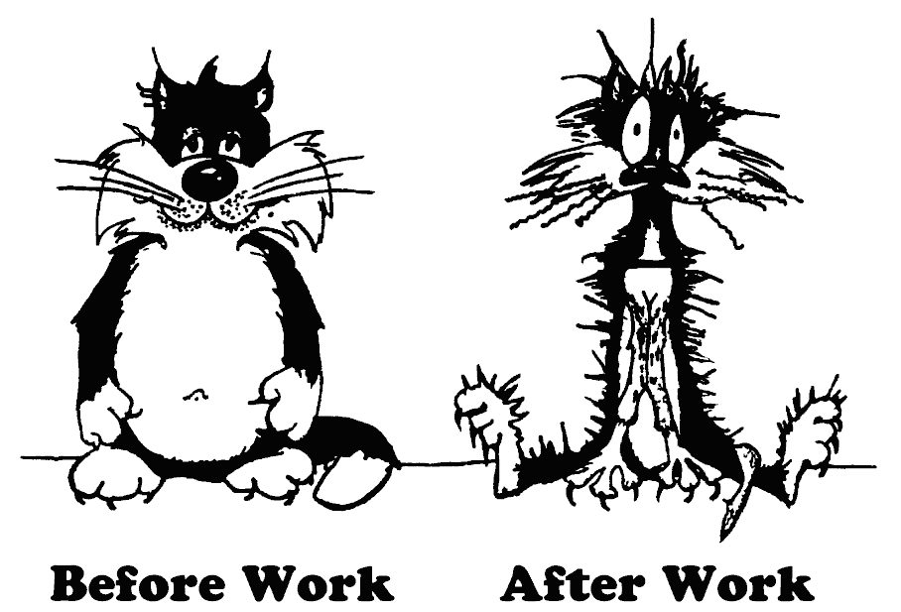
Starting with little humor…

Slide 3
Top 5 causes of stress in America
Job Pressure
Money
Health
Relationships
Poor Nutrition

Slide 4

The landscape of stress
24/7 society
On demand
Do more…with less
Email overkill
Cell phone craze
TMI (too much information)

Slide 5
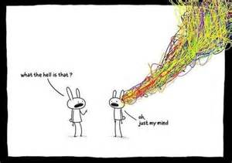
The busy mind

Slide 6



Definitions of stress…
“Stress is any CHANGE you encounter in your life.”
~ Serge King
“Stress is a perception. You can have the same situation but different interpretations.”
~ Brian Luke Seward, PhD
@jswellnessllc @NorthRisk

Slide 7

What is job stress?
National Institute for Occupational Safety and Health (NIOSH) defines job stress as:
“The harmful physical and emotional responses that occur when the requirements of the job do not match the capabilities, resources, or needs of the worker.”

Slide 8
Workplace stress facts (NIOSH Report)
An estimated 1 million workers are absent every day due to stress.
40% of workers report their job was “very stressful” or “extremely stressful”
25% view their jobs as the number one stressor in their lives
Job stress is more strongly associated with health complaints than financial or family problems

Slide 9

Workplace stress facts continued
65% of workers said that workplace stress had caused difficulties and more than 10% described these as having major effects;
10% said they work in an atmosphere where physical violence has occurred because of job stress and in this group, 42% report that yelling and other verbal abuse is common
29% had yelled at co-workers because of workplace stress.

Slide 10
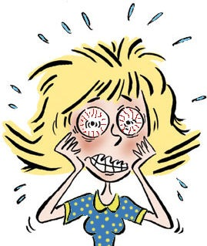
Workplace stress facts continued
One in five respondents had quit a previous position because of job stress.
One in four have been driven to tears because of workplace stress.

Slide 11
Workplace stress facts continued
62% routinely find that they end the day with work-related neck pain.
44% reported stressed-out eyes.
38% complained of hurting hands.
34% reported difficulty in sleeping because they were too stressed-out.

Slide 12

Lunch break, what is that?
Over half said they often spend 12-hour days on work related duties and an equal number frequently skip lunch because of the stress of job demands.
– Manpower Survey 2010

Slide 13
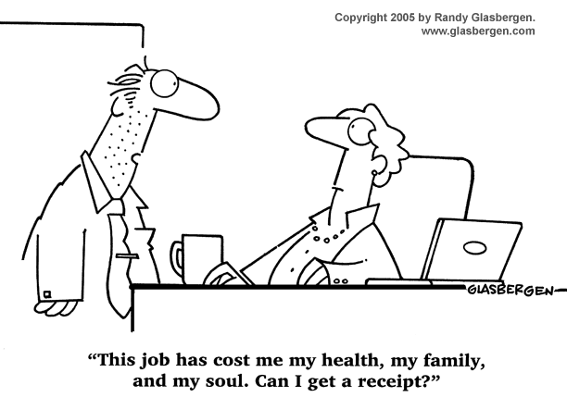
Health care expenditures are nearly 50% greater for workers who report high levels of stress. - Journal of Occupational
and Environmental Medicine
Stress is cited as the reason for over 50% of
worker compensation claims in the U.S.
- American Institute on Stress 2010

Slide 14

Job conditions that lead to stress
The design of tasks
Management style
Interpersonal relationships
Work roles
Career concerns
Environmental conditions

Slide 15
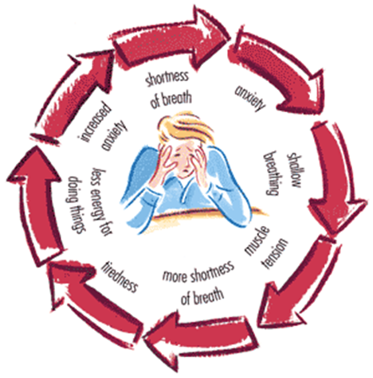
Job stress and health
Physiological Response
Heart Rate
Blood Pressure
Blood Clotting
Breathing
Metabolic Activity

Slide 16

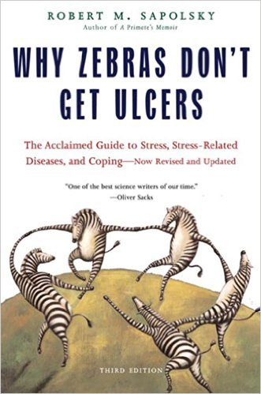

Job stress and health continued
Prolonged Effects of stress
Increased thyroid gland activity
Increased cortisol “the stress hormone” activity
Suppressed immune system

Slide 17
Not all stress is created equal
Good stress
Bad stress
Adrenalin rush
Challenge that energizes and motivates
Increased performance
Learning new skills
Left over adrenalin
Physical stress like muscle tension, headaches, ulcers, high blood pressure, heart disease

Slide 18
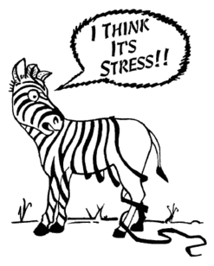
“Chronic stress is the grinding stress that wears people away day after day, year after year. Chronic stress destroys bodies, minds and lives. It wreaks havoc through long-term attrition.”
- The Stress Solution by Lyle H. Miller, PhD, and Alma Dell Smith, PhD

Slide 19
Warning Signs of job stress and burn out
Job Stress
Headache
Sleep disturbances
Difficulty in concentrating
Short temper
Upset stomach
Job dissatisfaction
Low morale
Burnout
Fatigue
Rudeness
Cynicism
Impatience
Intolerance
Pessimism
Back stabbing

Slide 20
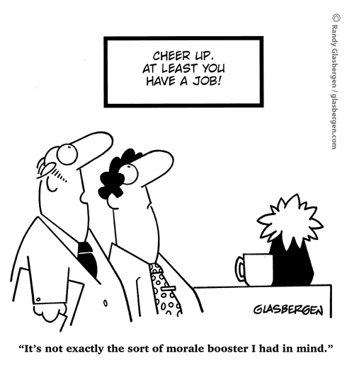
Stress, health and productivity
How do companies find the balance between employee health concerns and the need/desire to be productive and profitable in today’s economy?

Slide 21
Stress, health and productivity continued
Studies show that stressful working conditions are associated with increased absenteeism, tardiness, and intentions by workers to quit their jobs - all of which have a negative effect on the bottom line.
Recent studies of so-called healthy organizations suggest that policies benefiting worker health have a positive effect on the bottom line.
According to NIOSH – “A healthy organization is defined as one that has low rates of illness, injury, and disability in its workforce and is also competitive in the marketplace.”

Slide 22

Job stress carries a price tag…
Estimated at over $300 billion annually as a result of:
Accidents
Absenteeism
Employee turnover
Diminished productivity
Direct medical, legal, and insurance costs
Workers’ compensation awards as well as tort and FELA judgments

Slide 23
Stress is a modifiable lifestyle choice
One out of every four dollars employers pay for health care is tied to unhealthy lifestyle choices or conditions like smoking, stress and obesity, despite the fact that most large employers have workplace wellness programs.
University of Michigan completed a study on 10 modifiable risks – overall results indicate a need for increased awareness about the link between lifestyle and health.
“Modifiable risks are conditions or behaviors that employees can improve or eliminate by making healthier choices.”
– U of Michigan study report

Slide 24
Steps towards prevention
Organization change and stress management
What are the signs of job stress in your organization?
Are there any clues? Have you ever assessed the level of employee stress?
Do you have strategies for stress management within your wellness program?
Can you give top priority to changes that will help reduce job stress for your employees?

Slide 25
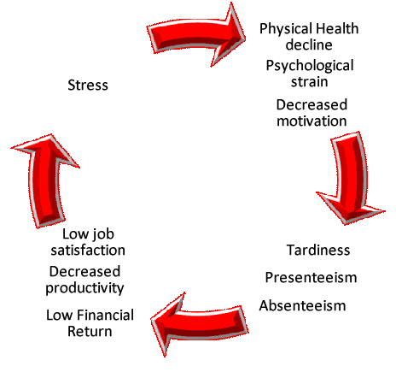
STEP #1: Recognize job stress

Slide 26

STEP #2: What are your current resources?
Fitness classes (yoga, stretching, breathing)
Outreach programs (resiliency or anger management)
Challenges
Lunch and learns
Workshops or webinars
Newsletters
Group coaching
1: 1 coaching
EAP program

Slide 27
STEP #3: Build strategies for stress management
Help employees manage their stress so they feel like they are in control of their lives and circumstances.
Increase their awareness
Motivate them to change
Assist them in building the skills necessary to change
Provide them opportunities to practice healthy lifestyles
The body craves balance, or a state of homeostasis. What do employees need in place to balance their stress (at work AND home)?
Effective relaxation techniques
Effective coping skills

Slide 28
STEP #4: Identify tools and resources
Perceived Stress Scale (Dr. Sheldon Cohen 1983)
Download for free at: http://www.mindgarden.com/132-perceived-stress-scale
Stress Assessment Tool (Franklin Covey)
Stress management program (EatSmartMoveMoreNC.org)
Post stress relieving tips in lounges, bathroom stalls, break rooms, conference rooms, etc.
Different approaches
Workplace venting stations (Appster)
Offering 1:1 attention (Lantern)
Mindfulness on demand (Google)
Daily stretching or movement
On-site wellness coach with a focus on stress and resiliency

Slide 29
STEP #5: Make stress management a priority
Get leadership understanding and support
Identify 2-3 small areas for improvement or change
Incorporate these changes into existing initiatives, programs, and policies
Highlight what YOU are doing to help employees with job stress
Use outside services and support (wellness coaching, on-site workshops or classes, EAP program, etc.)
Ask for employee feedback AND tell them how you will use it!

Slide 30



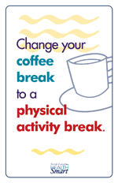

Stress management poster samples

Slide 31

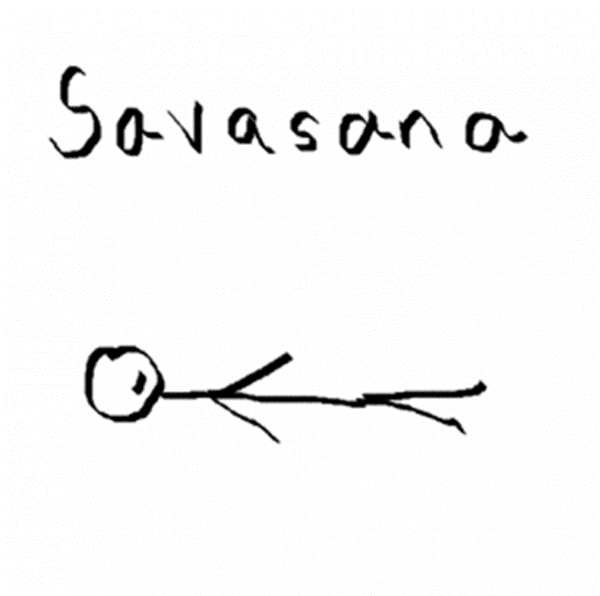
Complete Breath Exercise
This breath can be done in a comfortable seated position or in a lying down position.
Relax; close your eyes. Exhale completely.
Inhale slowly and deeply through your nose.
Allow your stomach to expand like a balloon noticing the breath in the chest making the sides of the ribs expand and the top corners of the chest left.
Feel the back floating ribs expand and press toward the floor, giving the sensation that there is a tiny floatation cushion under the middle back.
Notice how the belly expands and the diaphragm presses down to the low abs.
Hold your breath; exhale slowly through your nose, squeezing out all the stale air.
As you exhale feel the movement below the navel as the belly draws up and inward. Feel the sides of the ribcage draw inward and the shoulder blades glide down the back.
Allow the ribcage to settle back to the starting position.
Continue this exercise by counting your breath to maintain a rhythm; inhale for a count of 3 to 5, hold your breath for a moment, exhale for 5 to 7.
Repeat this sequence 5 time, relaxing deeper.

Slide 32
Benefits of deep breathing
Deep breathing techniques increase oxygen supply to nourish every cell in the body. The body’s response to an overabundance of oxygen in the blood is to slow down respiration rate and brain function, to allow carbon dioxide levels to return to normal. During this time, the mind and the body become very quiet. You can experience this stillness for moments at a time during your yoga practice. Breathing techniques help train your mind to tune out outside stimuli and to focus your energy and concentration resulting in a calm and relaxed feeling. The less anxious you become, the more you can detach yourself from all those busy thoughts and regain a sense of control. The more you practice deep breathing, the more energized your thoughts will become, and the more empowered you will feel.
- Jessie L. Sandoval, Empowering yourself through yoga, 2015

Slide 33

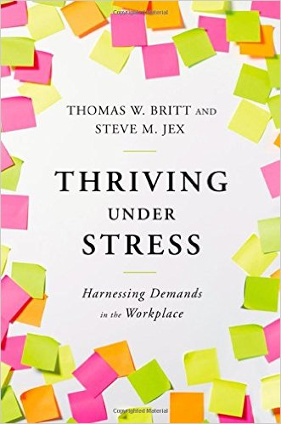

Resources and books to consider

Slide 34
References
Journal of Occupational and Environmental Medicine
American Institute of Stress
National Institute for Occupational Safety and Health
American Psychological Association
Statistic Brain Research Institute
National Wellness Institute
WELCOA
News medical (online)

Slide 35


Slide 36
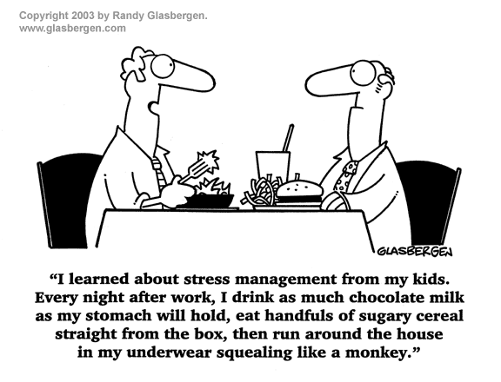
Ending with a little humor

Slide 37
Questions?

Slide 38

Ongoing support
As is true with all of our services, the value of our worksite wellness services is rooted in our capacity to provide you with customized ongoing support from an industry expert. North Risk Partners’ worksite wellness consultant, Jessie Sandoval, is available to talk you through all phases of the worksite wellness planning and implementation process.
About Jessie
Certified Worksite Wellness Specialist (CWWS) and Program Manager (CWWPM) through the National Wellness Institute
Certified Health Coach through the Institute for Integrative Nutrition
Registered yoga instructor with over 12 years of teaching experience (corporate, gym, studio and specialty classes)
Contact Information
Jessie L. Sandoval jessie@jswellnessllc.org 320.291.6285
@jswellnessllc @NorthRisk

