Slide 1
The Market Leader In Private Benefits Exchanges
Kevin Holler

Slide 2









Company overview
Liazon is the market leader in private exchanges
8 years of market experience
700+ broker partners, including 8 of the top 10
60+ medical and ancillary providers
960+ clients*
Award-winning technology
Acquired by Towers Watson in November 2013
“This was not only a smart business decision, it has given our employees greater satisfaction and peace of mind than we could have envisioned.”
- Bill Wagner,
CFO
*As of January 2015

Slide 3
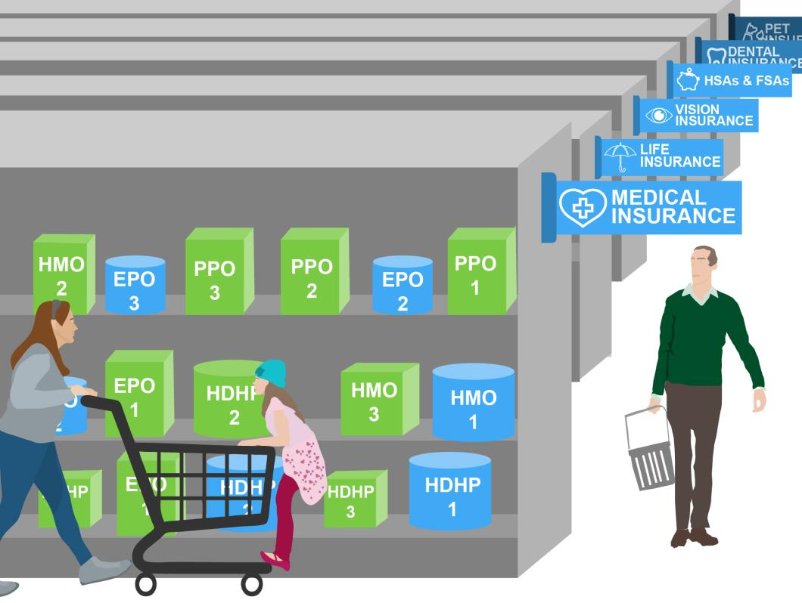
Let’s Define ‘Private exchange’
An online marketplace or store where employees shop for benefits that fit their needs –
often using money given to them by their employer (defined contribution)
3

Slide 4
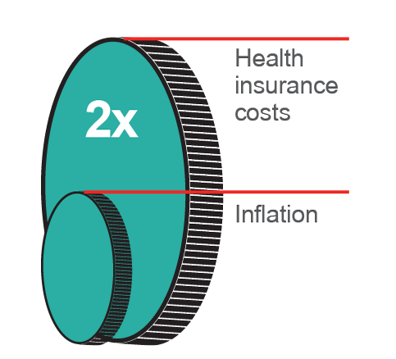
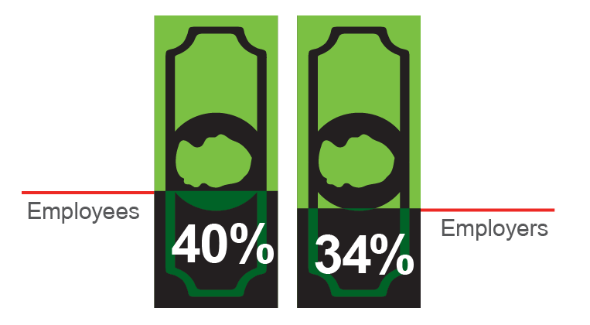
The cost of health care coverage is escalating at astronomical rates
Health insurance costs have increased double the rate of inflation¹
Employees contribute 40% more and employers contribute 34% more to health benefits than they both did five years ago¹
Did you know?
80% of companies offer their employees only one choice when it comes to health care coverage, yet most employees would be willing to pay a larger share of their health insurance premium if they had the opportunity to tailor benefits to their needs²
4

Slide 5
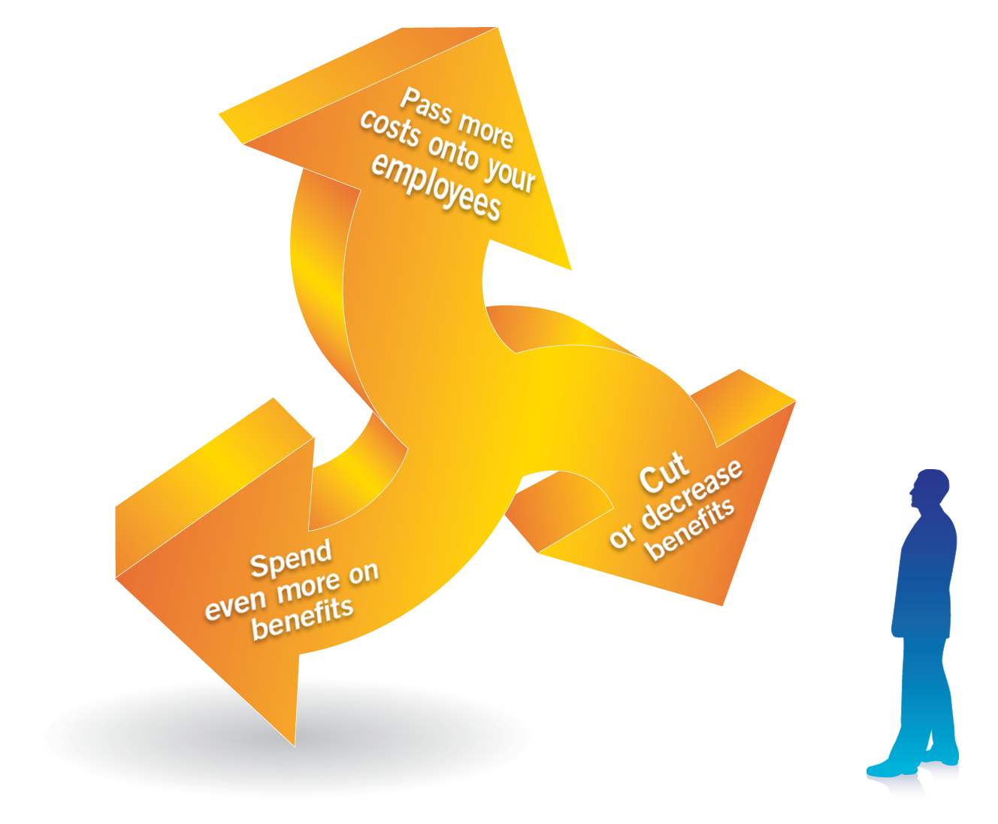
Why are these my only choices year after year?

Slide 6



Our model
Defined Contribution: Employer give employees money
Stop picking people’s plans
Gain financial predictability and control
(2) Private Exchange: People go shopping!
Big benefits store
Technology combines products to yield better, more personalized coverage
Personal recommendations based on individual needs and live support
Employer role in benefits becomes more like 401k program

Slide 7


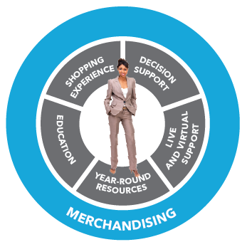


The Store is stocked with carefully curated products
Health
Protection
Medical
Accident
Critical Illness
Hospital Indemnity
Dental
Vision
Wellness
Telemedicine
Life
Disability (LTD and STD)
Legal Services
ID Theft Protection
Pet Insurance
Money
Lifestyle
HSA
FSA
Personal Time Off (PTO) Buy-Up
Notes:
Bright Choices isn’t just about superior technology. It’s also critical to stock the store with the best products to meet people’s needs.
Bright Choices is stocked with over 15 products that are critical for protection and that people value.
Health products provide financial protection for medical needs - medical insurance; supplemental health, including accident, critical illness, and hospital indemnity, depending on the market; dental, vision, wellness, and telemedicine.
Money accounts include HSAs and FSAs, including medical, dependent care, transit and parking FSAs.
And protection products include life, Short and Long-term disability, legal services, identity theft protection, and pet insurance.

Slide 8








Our decision support model
We provide a robust decision support tools to make it easy for individuals and families to select a benefits portfolio with the coverage they actually need.
Recommendation Engine
Uses sophisticated statistical modeling to predict the right combination of plans
Insurance Education
Contains accessible education about insurance and articles, videos and FAQs
Plan Summaries
Displays key components of plans simply and without insurance jargon.
Plan Comparison Tools
Produce a side-by-side comparison of key coverages, plan features and costs

Slide 9










Our recommendation engine
EMPLOYEE INPUT
^{EXPECTED UTILIZATION}
^{HEALTH}
^{STATUS}
^{NETWORK}
^{PREFERENCES}
^{INCOME}
^{SAVINGS}
^{RISK}
^{TOLERANCE}
^{HEALTH &}
^{FINANCIAL}
^{CONCERNS}
^{HEALTHCARE}
^{CONSUMERISM}
HEALTH
FINANCES
PERSONALITY
STATISTICAL MODELING
^{HEALTHCARE COSTS}
^{& UTILIZATION}
^{A sophisticated} algorithm creates a Recommendation ^{considering:}
• Types of plans that match people’s specific needs and wants
• A cost that balances premiums with expected out-of-pocket expenses
• A match to physician network preferences and overall desires and concerns
PUBLIC DATA
EMPLOYEE INPUT

Slide 10





Pinpointing a specific recommendation
Alicia
Chris & Family
Tom
Cost is $675
(includes her monthly
metro card)
Cost is $1,300
Cost is $550
LONG -TERM
DISABILITY
HSA
CRITIAL ILLNESS
LIFE
HEALTH COACHING
HMO
HEALTH PLAN
(Copay)
VISION
HDHP
HEALTH PLAN
LONG-TERM
DISABILITY
POS
HEALTH PLAN
TELEMEDICINE
TRANSIT FSA
ENHANCED
DENTAL
SHORT-TERM
DISABILITY
BASIC DENTAL
ACCIDENT

Slide 11
Decision Support , Enrollment and Support Services
Demo

Slide 12

Takeaways from 7 years and hundreds of thousands of enrollments
100% buy a different benefits package
~80% buy a different health insurance plan
Most buy something cheaper
People rarely cluster into one or two plans
~70% Dental Insurance
Even distribution across plans
~70% Disability Insurance (40% STD; 45% LTD)
~50% HSA-qualified plans
~50% Vision Insurance
~40% Life Insurance
Dramatic increases in policy amount
~30% Supplemental Health Insurance (accident, CI, hospital)
~15% Pet, Telemedicine, Legal, Wellness, etc.
In Year 2, 65% remain the same, 25% evolve, 10% make radical changes

Slide 13
Employees and employers are happy
Employees
Are happy 79%
Better value the $s their employer spends on their benefits 74%
Appreciate choice Only 2%
Employers
Control costs 83%
Streamline their benefits administration 73%
Enjoy the experience! 81%
of employees are satisfied with the shopping and enrollment experience
have seen spending hold or drop
say they’ve streamlined benefits administration, despite offering drastically more benefits options
are more aware of their employer’s contribution to their benefits
preferred letting their employer choose their benefits for them
were glad they switched!
“Very descriptive, simple, and quick. Everything you need in choosing your coverage!" Employee
“The interface is easy to use...It is very useful to us as an employer to be able to control our contribution each year and employees look at the choices as an added benefit.” Client

Slide 14
Discussion and Next Steps...
First make a conceptual decision on the private exchange model by thinking about the following questions...
Do we believe that people should buy their own benefits and not companies for them?
Do we believe in the 4 core concepts of DC, Choice, Employee Empowerment, Technology
What are the biggest obstacles and challenges that we foresee?
What value will this bring to our organization and people?
Next Steps:
Defined Contribution modeling
Obtain carrier quotes and store modeling
Executive buy-in
Technical Review Meeting
Review Implementation timelines and requirements
Create a communication and education plan

